Slide 1
Civil Commitment:
Dubious Solution to a Serious Problem?
Raymond Knight, Ph.D.
Notes:
Drs. Kaitlyn Peretti and Brooke Berard will talk on treatment and management of incarcerated offenders.

Slide 2
Overview of the Presentation
History of the civil commitment of sex offenders in the US
Current status of SO civil commitment in the USA
History and process of commitment in MA
Pros and cons of commitment

Slide 3
History of Civil Commitment
Part I
Notes:
.

Slide 4



Sex Offender Civil Commitment Timeline
SO not mentally ill
Treatment ineffective
Costly to maintain
Shift to determinative sentencing
Reaction to high profile crimes and public outrage
MN
26 states
+ DC
waned
WA
CA, IL, MI, MN
20 states
+ DC
Nothing works era in
Criminology
Martinson (1977)
1930
1940
1950
1960
1970
1980
1990
2000
2010
Reaction to case of released offender who sexually murdered 2 young boys
Gov. Dukakis Panel determines that SDP law does not enhance public safety. Law abolished.
MA
MA
MA

Slide 5
Current Civil Commitment in USA
Part II

Slide 6
Twenty States + DC with Commitment

Slide 7

Twenty States + DC with Commitment
DC

Slide 8
Basic Requirements for Commitment
A history of sexual violence;
A current mental disorder or abnormality;
A likelihood of future sexual crimes;
A link between the first two elements and the third.
(Janus, 2000)

Slide 9
Many Differences
Commitment criteria range from “beyond reasonable doubt” to “clear and convincing evidence” to “likely” to reoffend;
Some allow juveniles to be considered for commitment (WI, WA, IL, FL, PA);
Some impose limited commitment; others indefinite.
Use slightly different emphases in definitions (e.g., MN “psychopathic personality; FL “pattern of repetitive, compulsive behavior.”

Slide 10
Twenty States + DC with Commitment
38.6
5.4
64.9
N.A.
34.7
N.A.
30.7
1.8
5.0
21.9
13.5
25.8
8.1
DC
147.3
10.9
9.8
2.9
11.3
0.9
23.3
Budget 2007 in Millions $

Slide 11
Twenty States + DC with Commitment
2015 Budget
38.6
5.4
64.9
80.9
N.A.
34.7
N.A.
30.7
1.8
5.0
21.9
13.5
25.8
8.1
DC
147.3
10.9
9.8
2.9
11.3
0.9
23.3
Budget 2007 in Millions $

Slide 12
Twenty States + DC with Commitment
48.1
6.7
80.9
N.A.
43.3
N.A.
38.3
2.2
6.2
27.3
16.7
32.2
10.1
DC
183.6
13.6
12.2
3.6
14.1
1.1
29.0
Estimated Budget 2015 in Millions $

Slide 13
Costs
Funding for screening;
Evaluation;
Trials and appeals;
Incarceration/confinement costs;
Treatment while incarcerated;
Release programs;
Community training programs;
Post-release supervision.
Notes:
Levenson (2010?) – cost per committed offender varies from $70,000 to $103,000 per year.

Slide 14


Costs
Because of low release rate, committed offenders, and therefore costs, continue to increase.
Commitment Costs

Slide 15

Twenty States + DC with Commitment
DC

Slide 16
SDP History and
Process in Ma
Part III

Slide 17
Sex Offender Civil Commitment Timeline
CA, IL, MI, MN
26 states
+ DC
waned
WA
20 states
+ DC
1930
1940
1950
1960
1970
1980
1990
2000
2010
1960
1970
1980
1990
MA
MA
MA
MA
MA
Notes:
1938-1939-California, Illinois, Michigan, and Minnesota– this developed out of a movement that medicalized criminality and emphasized treatment over punishment.
At its height 26 states + DC had civil commitment for sex offenders
In contrast to the present situation, commitment was an alternative to criminal sentencing
In the 60’s and 70’s declined because SO not considered mentally ill, treatment not scene as effective, and costly
As waning, MA hit by severe case of an offender who was being released from prison, indicating that he was going to offend. Nothing could be done and he killed 2 young boys
Wave 2
All share the three necessary commitments requirements –
"sexually violent predator" as a person
who has been convicted of or charged with a sexually violent offense and
who suffers from a mental abnormality or personality disorder
that makes the person likely to engage in acts of sexual violence.

Slide 18
MA Timeline: Wave I
State prison offenders were recommended for commitment
5000
1900
1900
570
1900
1330
570
1330
570
1330
Offenders were transferred to MTC for a full evaluation
570
1330
Offenders Committed
Released back to prison
1960
1960
1970
1980
1990
1970
1980
1990

Slide 19
MA Timeline: Wave I
CA, IL, MI, MN
26 states
+ DC
waned
WA
20 states
+ DC
1930
1940
1950
1960
1970
1980
1990
2000
2010
1960
1970
1980
1990
MA
MA
MA

Slide 20
MA Timeline: Wave II
CA, IL, MI, MN
26 states
+ DC
waned
WA
20 states
+ DC
1930
1940
1950
1960
1970
1980
1990
2000
2010
2000
2010
MA
MA
MA
MA

Slide 21
MA Timeline: Wave II
2000
2010
MA

Slide 22
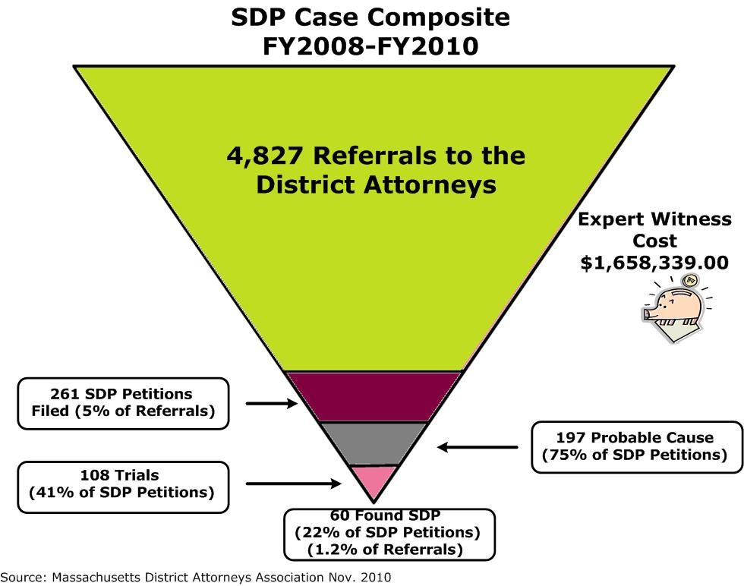
MA Timeline: Wave II
Offenders were referred for commitment
?
?
251
?
Offenders were transferred to MTC for a full evaluation
122
Offenders Committed
Released
2000
2010
Released from Commitment

Slide 23
To
MTC
MTC
Notes:
261 SDP petitions
197 Probable Cause
108 trials
60 Found SDP

Slide 24
Process
Offender committed to MTC for 60 day evaluation
c. 123 s. 13(a)
QEs provided access to
all reports and records
After determined Probable Cause, report to court
by 2 QEs within 45 days after commitment
D.A./A.G. withdraws petition within
14 days of QEs’ report to court
D.A./A.G. files petition for trial within
14 days of QEs’ report to court
c. 123 s. 14(a)
Offender remains committed to MTC
c. 123 s. 14(a)
Trial held within 60 days of petition
(may be continued for good cause)
c. 123 s. 14(a)
© Middlesex District Attorney’s Office 2003
Notes:
261 SDP petitions
197 Probable Cause
108 trials
60 Found SDP
D.A./A.G. = District Attorney and Attorney General
QE = Qualified Examiner –are Designated Forensic Professionals-- Licenced psychiatrist or psychologist with 2 years of experience with the dx or trt of sex offenders.
QE credentials
Required to give the Static-99R as part of the evaluation.
Turay v. Seling/Weston -- Probable Cause in Washington

Slide 25
Process (cont.)
Trial held within 60 days of petition
(may be continued for good cause)
c. 123 s. 14(a)
© Middlesex District Attorney’s Office 2003
Notes:
D.A./A.G. = District Attorney and Attorney General
QE = Qualified Examiner

Slide 26
Process (cont.)
Trial held within
60 days of petition
Unanimous jury finds SDP
beyond reasonable doubt
NO
YES
Committed to MTC for day to life
c. 123A s. 15(d)
Offender released
Held until release
Pursuant to M.G.L. c. 123A s. 9)
© Middlesex District Attorney’s Office 2003

Slide 27
Static-99R Scores

Slide 28
MA Timeline: Wave II Estimated
Estimated Offenders were referred for commitment
20,270
1095
251
844
Estimated Offenders were transferred to MTC for a full evaluation
122
Offenders Committed
Released
2000
2010
Released from Commitment

Slide 29
Pros and cons of Commitment
Part IV

Slide 30
Pros of Commitment
State is provided with a mechanism to protect public from a dangerous offender who poses an immediate threat.
Solution has “intuitive simplicity,” if it is really possible to identify the most serious offenders.

Slide 31
Cons of Commitment: Definitional
Typically used mental disorders (paraphilias, personality disorders, and impulse disorders) are dimensional, not categorical, and empirical bases for traditional cutoffs are limited.
Links of specific mental disorders to the prediction and/or frequency of sexual coercion are often tentative.

Slide 32
Cons of Commitment: Definitional
Criteria for the projected likelihood of sexual recidivism are vague, and hard to justify empirically.
For example – 2 to 25 year follow-up recidivism rate of high category in Static 99R (6 or greater) for those committed to MTC was 34.9%.

Slide 33
Cons of Commitment: Prediction
Supreme Court approval of civil commitment was predicated on high prediction efficacy of actuarials.
Although the predictive potency of current empirical actuarials is adequate for differentiating among offenders for treatment and management, even if done under optimal conditions (mechanically applied), they are inadequate to the task of indeterminate commitment, because of the high cost of false positives and the low baserate of SDV.

Slide 34
Cons of Commitment: Prediction
So, in optimal predictive practice, recidivism prediction is suboptimal for commitment prediction.
BUT, SDP decisions are adjusted, first by QEs and then by a jury of non-experts, thereby reducing predictive efficacy.
Thus, the representation of low-risk committed offenders among committed.

Slide 35
Cons of Commitment: Treatment
Catch 22 – without participating in treatment offenders cannot demonstrate they have learned from past transgressions so that they can be judged fit for release.
BUT, participating in treatment they incriminate themselves.
Moreover, it is hard to judge improvement during incarceration.

Slide 36
Alternatives to Commitment

Slide 37
Alternative to Commitment
SDP status increases criminal sentence, which includes treatment;
Lifetime probation (e.g., Arizona);
Outpatient commitment program (e.g.,Texas).

